Slide 1

Using Artificial Intelligence & Machine Learning to Predict Company Bankruptcy
CAP 1990C: AI THINKING FINAL PROJECT
BY: JOEMICHAEL ALVAREZ, FRANK RODRIGUEZ, & MICHAEL SEMAN

Slide 2

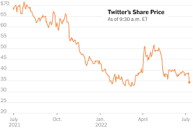

I DECLARE BANKRUPTCY!!!!!!!!!
Notes:
So we discovered an amazing dataset with real data on companies in Taiwan, their financial information and whether they went bankrupt. Our goal was to use machine learning and AI to develop models that could predict if a company would or would not go bankrupt given a multitude of predictors.

Slide 3
A Breakdown of Our Team’s Journey
Exploration of our Dataset
Evaluating Machine Learning Models
Principal Component Analysis: A Love Story
A Quick Dive into XGBoost
Tackling Bankruptcy with the A.I. of Dataiku
Who did it best?

Slide 4
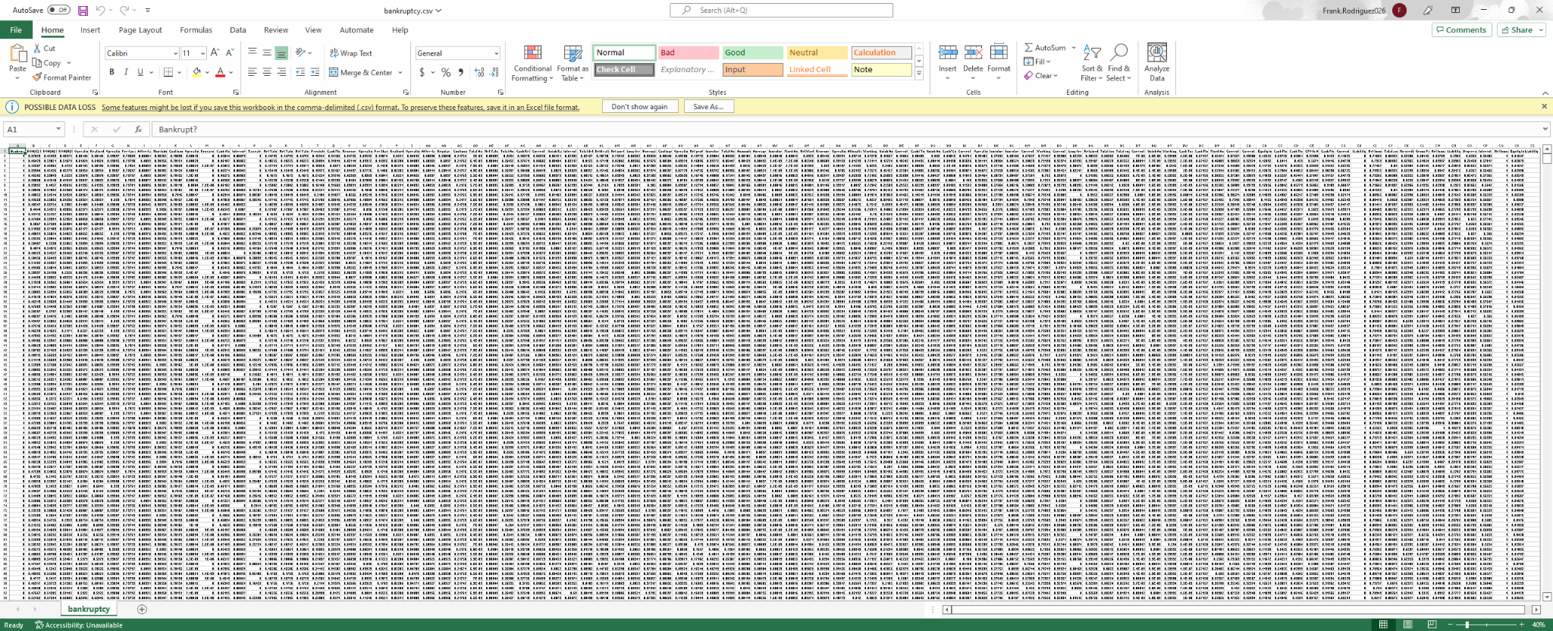
The Dataset

Slide 5


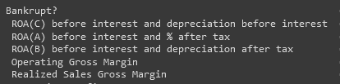
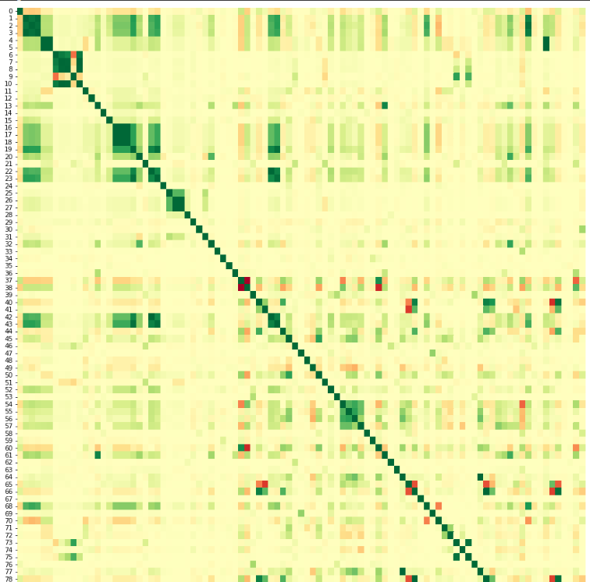
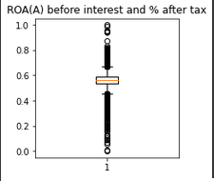

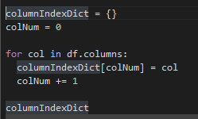
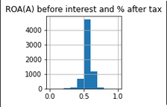
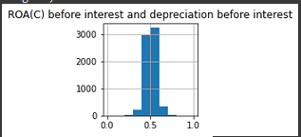
Exploratory Data Analysis (EDA)
Dataset Size
Target Variable Balance
Column Names
Column Data Types
Forget Column Names

Slide 6
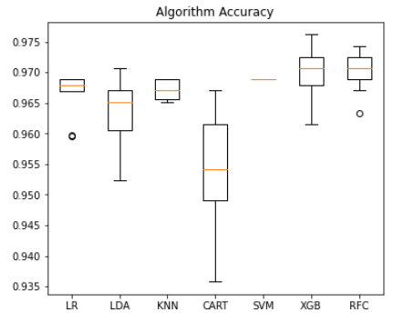
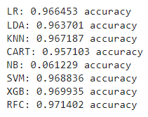
Evaluating Machine Learning Models Based on: Accuracy
Logistic Regression (LR).
Linear Discriminant Analysis (LDA).
K-Nearest Neighbors (KNN).
Classification & Regression Trees (CART).
Gaussian Naive Bayes (NB).
Support Vector Machine (SVM).
XGBoost (XGB).
Random Forest (RFC).
Don’t be fooled by these scores!
96.3% of our data was of the ‘No’ class for Bankruptcy. Meaning a dummy model only predicting ‘No’ would have a .963343 accuracy!!!
Notes:
I selected 8 different models to evaluate. Initially we ran our data through a harness that showed each’s models accuracy score. At first glance, it seems like all the models (save NB which is omitted from the graphic) performed extremely well. But…. Our dataset is very imbalanced.
So while initially these values seemed great, you have to take into account the imbalance. 96.3% of our records were from companies that did NOT go bankrupt. That means a model that ONLY predicted NO every single time, would have a 96.3343% accuracy. So while these scores that looked great to begin with, they are actually not that impressive.

Slide 7
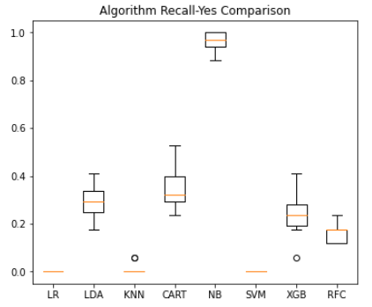
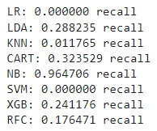
Evaluating Machine Learning Models Based on: Recall of the ‘Yes’ Class
Logistic Regression (LR).
Linear Discriminant Analysis (LDA).
K-Nearest Neighbors (KNN).
Classification & Regression Trees (CART).
Gaussian Naive Bayes (NB).
Support Vector Machine (SVM).
XGBoost (XGB).
Random Forest (RFC).
Don’t be fooled by these scores either!
Naïve Bayes has a 96% recall, but that’s because it was predicted ‘Yes’ almost every time (6% accuracy). Remember that Precision, Recall, F1-Score, and Accuracy all important metrics to consider.
Notes:
As a group We decided that the most important metric to focus on was the recall for the Yes class. We wanted our model to be best at determining which companies would go bankrupt. These are the results. Naïve Bayes jumps to the top of the list… but bear in mind this is because this model predicted yes almost every single time. This is why previously that model showed up to be so inaccurate. Moving forward the models that stand out are Classification and Regression Trees, Linear Discriminate Analysis, and Xgboost which I will discuss more later.

Slide 8
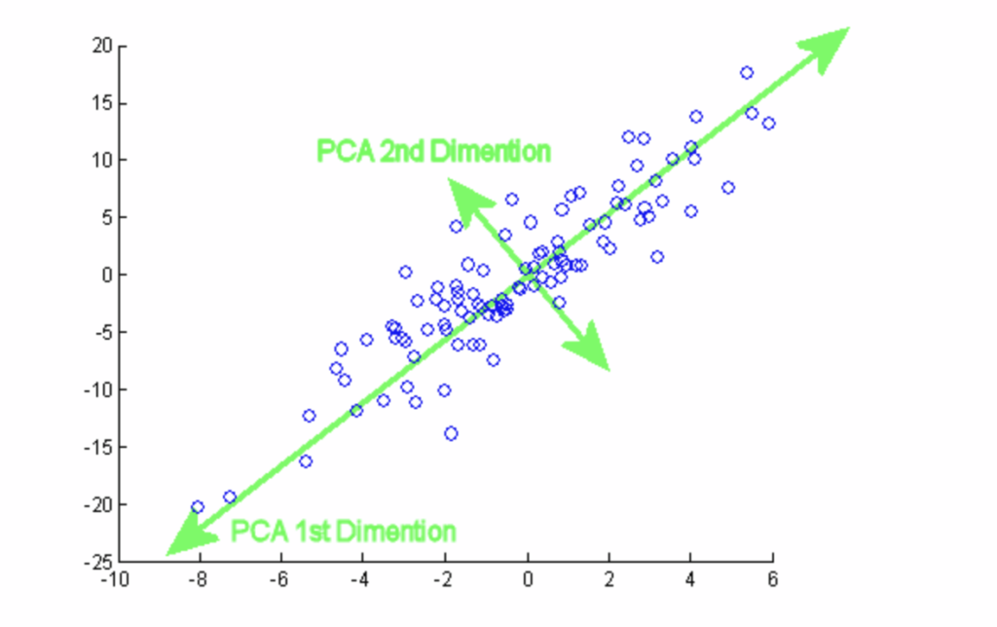


Principal Component Analysis (PCA)
Popular to use when dealing with larger datasets
Reduces the dimensionality of a dataset
Using linear algebra, variables converted to components
Designed lower amount of variables while keeping variability

Slide 9
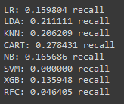
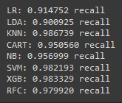
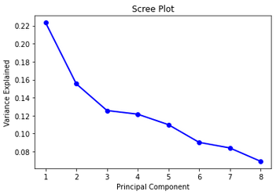
Evaluating PCA Machine Learning Models
Logistic Regression (LR).
Linear Discriminant Analysis (LDA).
No SMOTE
Using SMOTE
K-Nearest Neighbors (KNN).
Classification & Regression Trees (CART).
Gaussian Naive Bayes (NB).
Support Vector Machine (SVM).
XGBoost (XGB).
Random Forest (RFC).

Slide 10
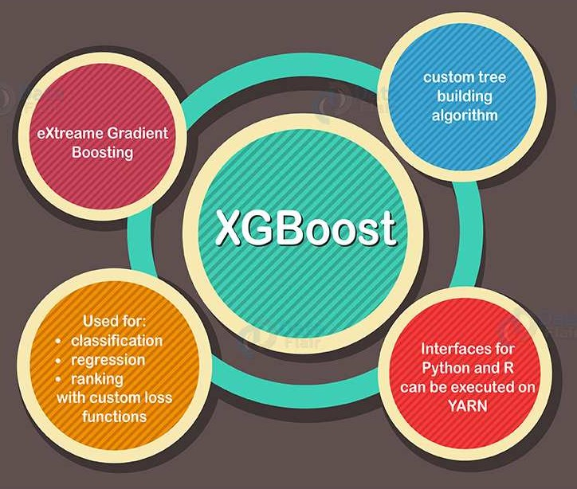


What is XGBoost?
A widely used supervised Machine Learning algorithm
Works with many programming languages including Python
Implementation of gradient boosted decision trees
Designed for high speed and performance
Notes:
I chose to focus on fine tuning the performance of one model: XGBoost. So what is XGBoost? XGBoost is a commonly used ML algorithm for supervised learning. It was created by a PHD Student at the University of Washington and released in 2014. It’s name refers to the software’s engineering (X) Goal (G) to push the limits of boosted tree algorithms. It can be used with most popular programming languages. It works by combining multiple weak decision trees into a powerful committee, a technique called gradient boosting. It was designed to be fast while still performing extremely well. I chose this model due to its high initial performance with recall, and my unfamiliarity with it. I wanted to learn more.

Slide 11
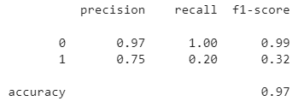
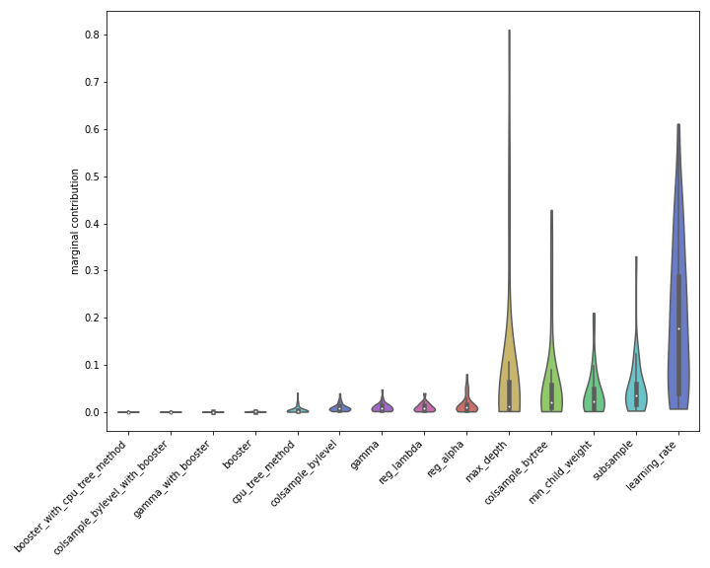
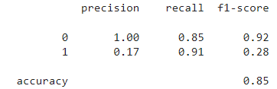
Started from the Bottom Now We’re Here
Tuning Techniques:
Under sampling
Over Sampling
MSMOTE
Cross Validation on 7 different hyperparameters
Before Tuning:
9/44 Bankrupt Companies Predicted Correctly
After Tuning:
40/44 Bankrupt Companies Predicted Correctly
Notes:
So most of what I did was tedious Machine Learning work. In summation, I tried under, over sampling as well as MSMOTE. Undersampling gave the highest recall, so I decided to tune 7 different hyperparameters using the undersampled training data. Before tuning, our model predicted only 9 of the 44 bankrupt companies correctly from the test data. After all my work tuning, our model was able to predict 40/44 companies that went bankrupt. It should be noted that we sacrificed precision of the yes class and overall accuracy in order to achieve this result.

Slide 12
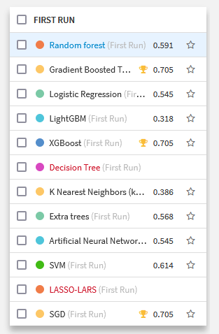
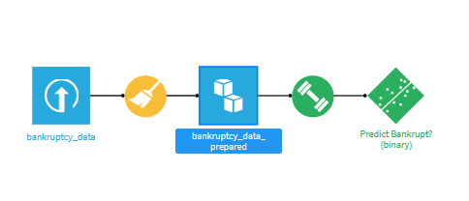
Cleaning and Modeling in Dataiku
Data Preparation
Exploratory Data Analysis
Model Selection
Model Execution
Notes:
Explain similarities to standard machine learning practices in prep and EDA. Go through the process of model selection and execution within Dataiku.

Slide 13
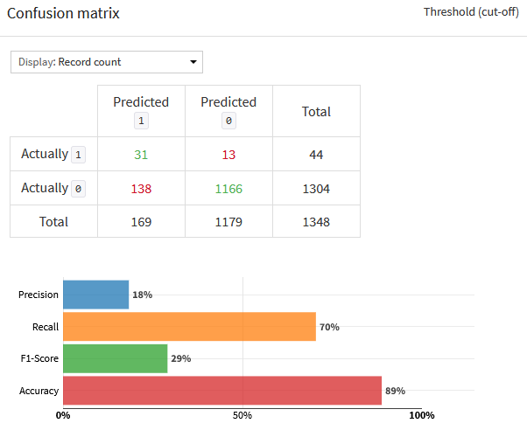
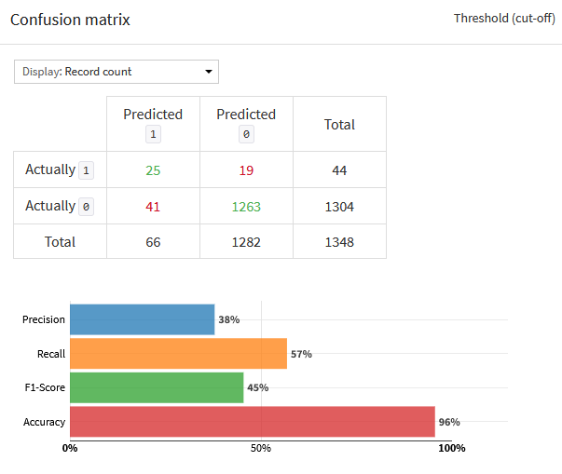
Dataiku Final Modeling Results SGD XGBoost
Notes:
Introduce the models that made the final cut. (XGBoost, Gradient Boosted Decision Trees, and Stochastic Gradient Descent).

Slide 14
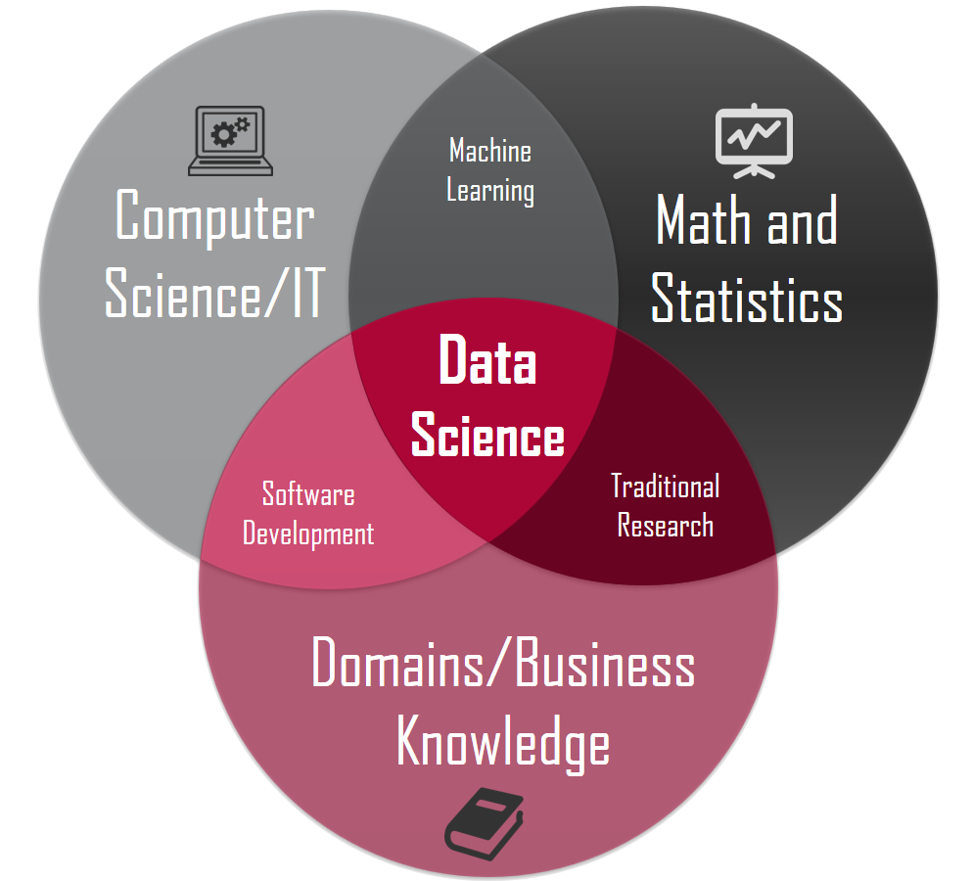
Who did it best?
Both Dataiku and standard practice require understanding your data enough to transform, clean, and process it
Both use similar modeling, and when similar models are not available, Dataiku allows users to create custom models
Despite this a handmade tuned model using machine learning libraries will, more likely than not, outperform a premade model

Slide 15
Works Cited
https://data-flair.training/blogs/gradient-boosting-algorithm/
https://data-flair.training/blogs/xgboost-algorithm/
https://www.analyticssteps.com/blogs/introduction-xgboost-algorithm-classification-and-regression
https://towardsdatascience.com/introduction-to-statistics-e9d72d818745
https://www.kaggle.com/datasets/fedesoriano/company-bankruptcy-prediction

